Slide 1
Long Short Term Memory (LSTM)

Slide 2
Why Use these types of Networks
Excellent for time-series type of data, what the UC Boulder rnn model uses
LSTMs help preserve the error that can be backpropagated through time and layers
Remember we are trying to minimize error to model the data
Want to have access to this backpropagation
Feed Forward NN have “amnesia” to previous inputs/outputs
In time-series or other data, need to have model be influenced by previous data points, especially the recent ones → Name “Long Short Term Memory”

Slide 3
What is special about lstm
contain information outside the normal flow of the recurrent network in a gated cell
Information can be stored in, written to, or read from a cell, much like data in a computer’s memory
cell makes decisions about what to store, and when to allow reads, writes and erasures, via gates that open and close
cells learn when to allow data to enter, leave or be deleted through the iterative process of making guesses, backpropagating error, and adjusting weights via gradient descent

Slide 4
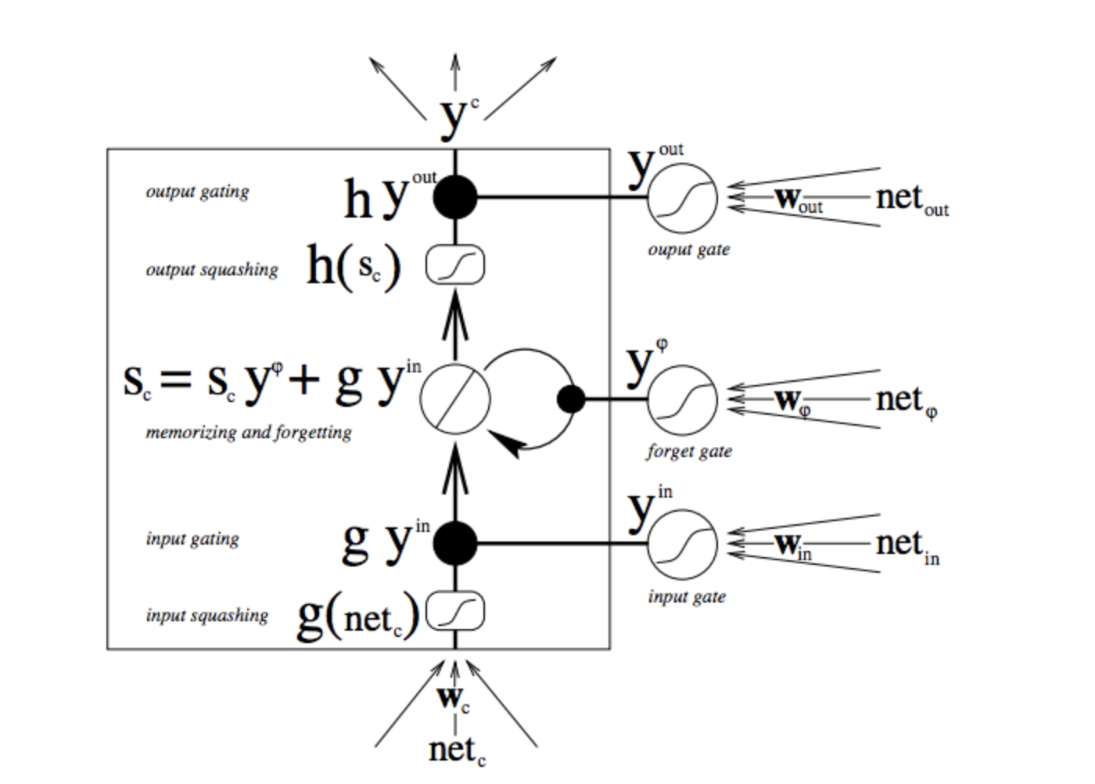
Diagram for CELL
TRIPLE ARROWS SHOW WHERE INFORMATION FLOWS INTO THE CELL AT MULTIPLE POINTS, AT BOTTOM
COMBINATION OF PRESENT INPUT AND PAST CELL STATE IS FED NOT ONLY TO THE CELL ITSELF, BUT ALSO TO EACH OF ITS THREE GATES, WHICH WILL DECIDE HOW THE INPUT WILL BE HANDLED
BLACK DOTS ARE GATES THAT DETERMINE RESPECTIVELY WHETHER TO LET NEW INPUT IN, ERASE THE PRESENT CELL STATE, AND/OR LET THAT STATE IMPACT THE NETWORK’S OUTPUT AT THE PRESENT TIME STEP
S_c IS THE CURRENT STATE OF THE MEMORY CELL, AND g_y_in IS THE CURRENT INPUT TO IT
CELL CAN FORGET ITS STATE, OR NOT; BE WRITTEN TO, OR NOT; AND BE READ FROM, OR NOT, AT EACH TIME STEP
NOTE ”+” SIGN → PRESERVERS ERROR, WHICH CAN BE BACKPROPAGATED

Slide 5
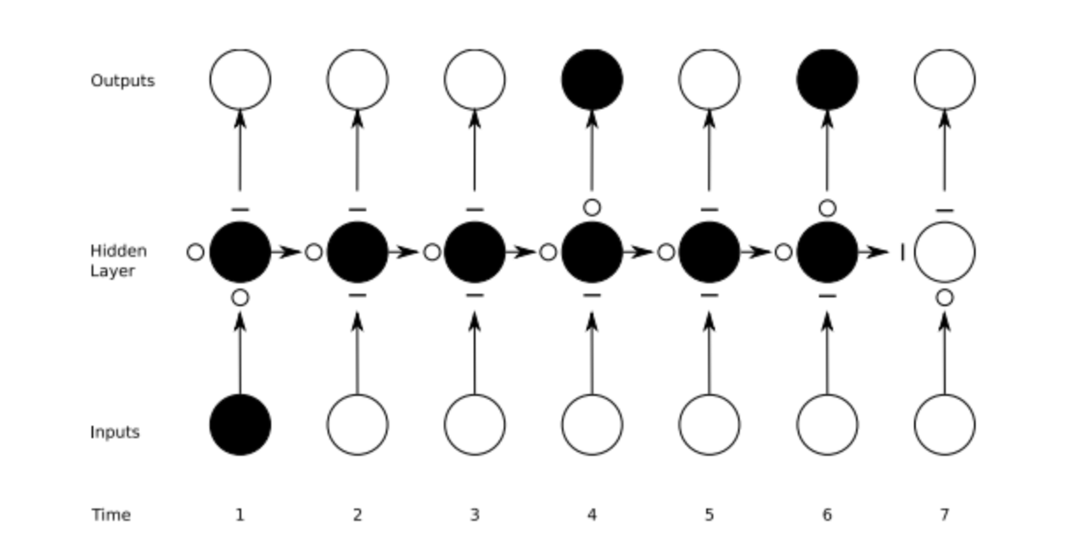
MANY GATES AT WORK
STRAIGHT LINES ARE CLOSED GATES
BLANK CIRCLES ARE OPEN GATES
RECURRENT NETS MAP ONE-TO-MANY

Slide 6
THANKS FOR LISTENING
SOURCE: https://wiki.pathmind.com/lstm

